Slide 1
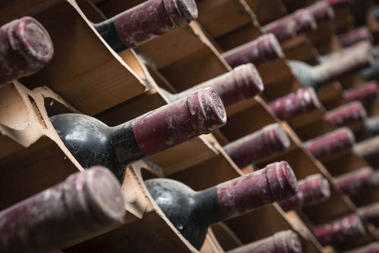

Wine Quality
Prediction
Baoheng Kuang | Yaqi Zhang | Yunran Qiu
CHE 1147
Group Project

Slide 2
CONTENTS
01
02
03
04
Background and Project Statement
Exploratory Data Analysis
Data
Processing
Conclusion
and Discussion

Slide 3

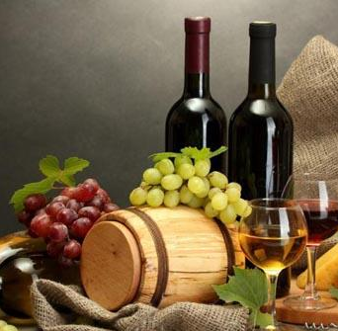





01
Background and Problem Statement
Wine is one of the most popular drinks in the world.
Our goal is to provide a reference standard for wine manufacturer to price their products and give wine buyer a proper guidance.
freshness and low alcohol
Vinho Verde
The dataset is from the UCI Machine Learning Repository, related to red and white variants of the Portuguese "Vinho Verde" wine.
Minho region of Portugal

Slide 4
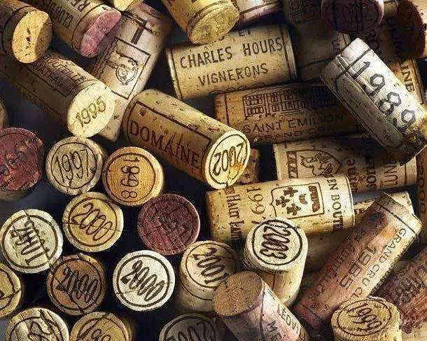
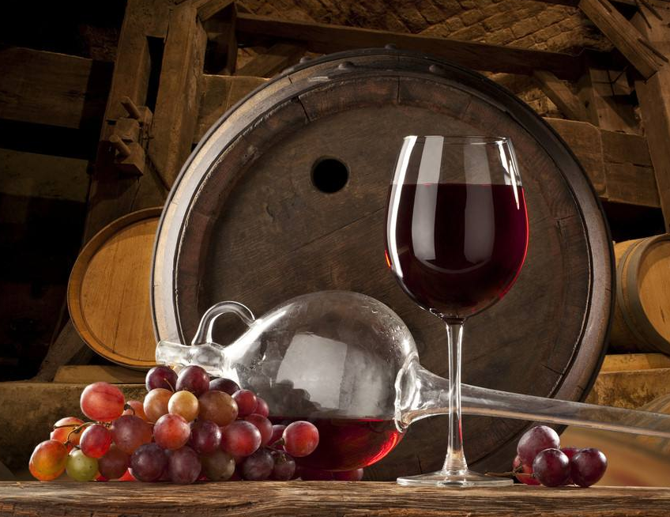

01
Background and Problem Statement
Dataset
The dataset contains quality ratings of 6,497 variants of “Vinho Verde” wines
with 38 missing values found in 34 samples.
Input variables
Outputs
0 - type
1 - fixed acidity 2 - volatile acidity 3 - citric acid 4 - residual sugar 5 - chlorides 6 - free sulfur dioxide 7 - total sulfur dioxide 8 - density 9 - pH 10 - sulphates 11 - alcohol
Quality ratings
Low: 3, 4
Medium: 5, 6
High: 7, 8, 9

Slide 5
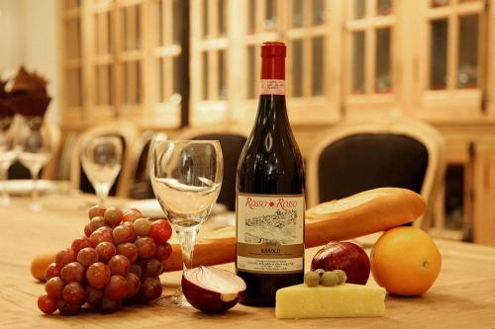
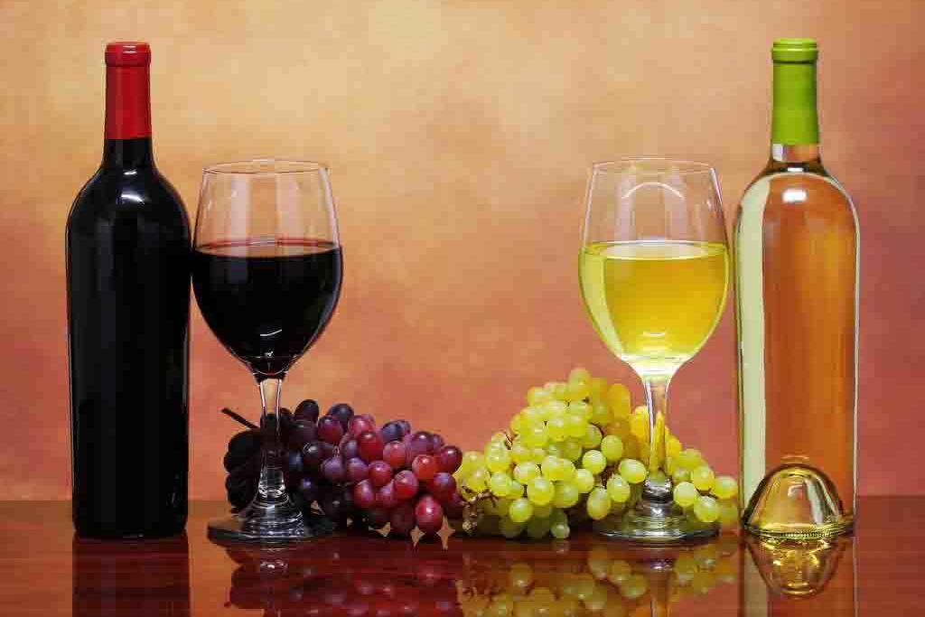


01
Background and Problem Statement
Questions
Physicochemical properties
Quality classifications
Can we predict the quality rating of each wine sample, which can be high, medium or low ?
What properties does high-quality wine have?

Slide 6
CONTENTS
01
02
03
04
Background and Project Statement
Exploratory Data Analysis
Data
Processing
Conclusion and Discussion

Slide 7
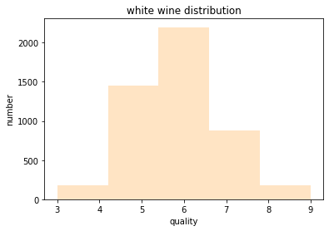
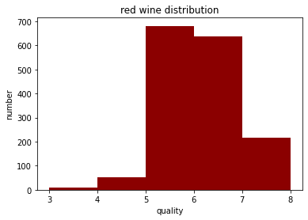
02
Exploratory Data Analysis
Histograms

Slide 8
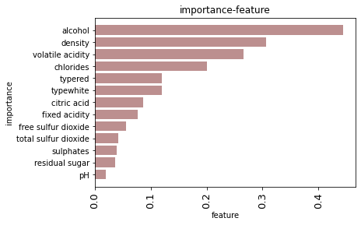
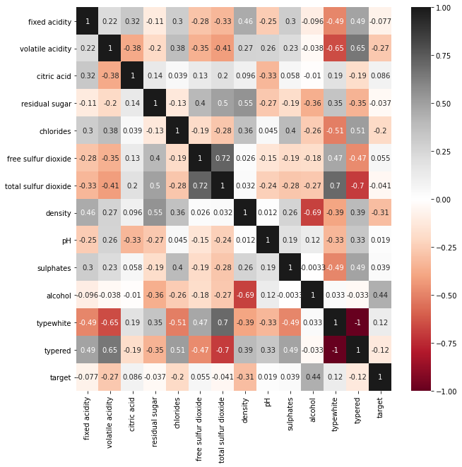
02
Exploratory Data Analysis
Heat Map
Identify correlation
Free sulfur dioxide and total sulfur dioxide have a great relationship.

Slide 9
CONTENTS
01
02
03
04
Background and Project Statement
Exploratory Data Analysis
Data
Processing
Conclusion and Discussion

Slide 10

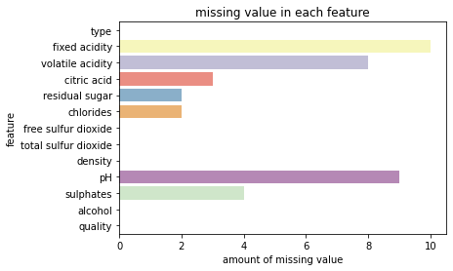

03
Feature Selecting
Modelling
Data Processing
Data Cleaning
Missing Values Distributions:
Replace with mean values
AVG
Code
for i in dfwine.columns.tolist():
dfwine[i]=dfwine[i].fillna(dfwine[i].mean())

Slide 11
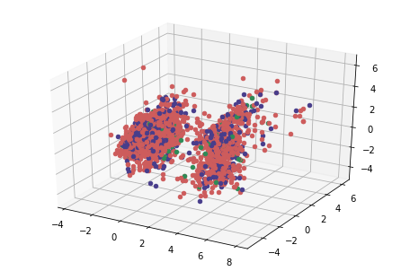
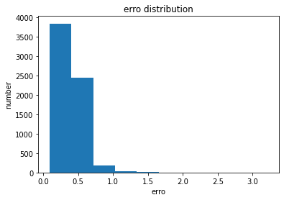

03
Feature Selecting
Modelling
Data Processing
Data Cleaning
Use PCA to find outliers：
Outliers
We do not know why this outlier appear, if they are caused by mistaken counts, we will remove it, if they are just strange sample as they should be, we will keep it. here we just keep them and see what happen in next few steps.

Slide 12
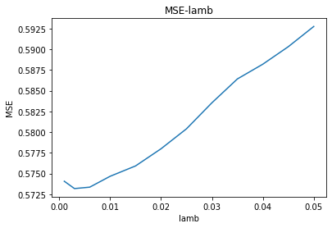
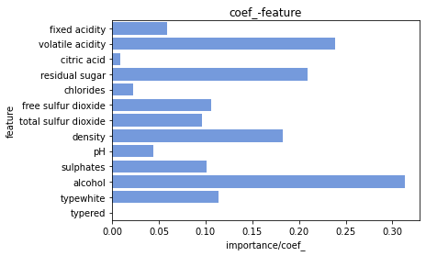
03
Feature Selecting
Modelling
Data Processing
Data Cleaning
Use Lasso to do feature selection：
Drop the “typered” feature
lambda=0.003：Minimum MSE

Slide 13
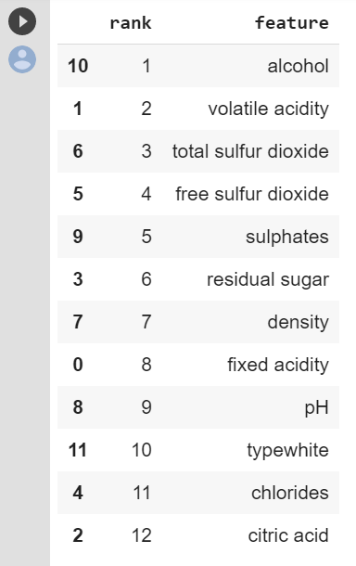
03
Feature Selecting
Modelling
Data Processing
Data Cleaning
Supervised: Logistic Regression models (5 folds)
Logistic Regression with l1 regularization
Feature importance
Accuracy(C=0.5, solver=liblinear): 58.21%
Logistic Regression with l2 regularization
Accuracy(C=0.5, solver=liblinear): 58.28%

Slide 14
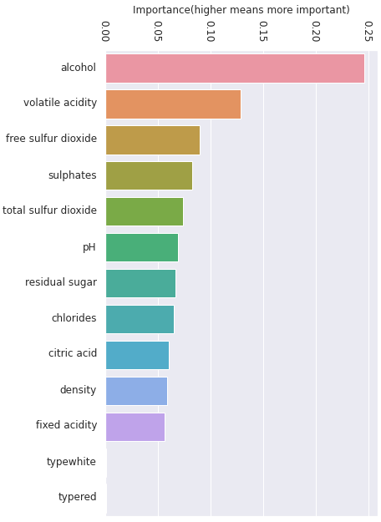
03
Feature Selecting
Modelling
Data Processing
Data Cleaning
Supervised: Tree-based models(5 folds)
Logistic Regression with l1 regularization
Accuracy(C=0.5, solver=liblinear): 58.21%
Logistic Regression with l2 regularization
Accuracy(C=0.5, solver=liblinear): 58.28%
Random Forest Regression
Feature importance
Accuracy(max_depth=40, n_estimators=200): 49.47%
Random Forest Classification
Accuracy(max_depth=30, n_estimators=300): 70.16%
XGBoost
Accuracy(n_estimator=25, max_depth=10):64.09%

Slide 15
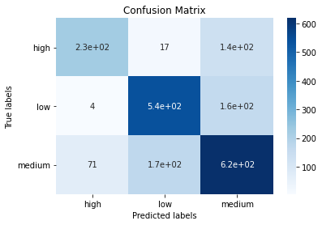

03
Feature Selecting
Modelling
Data Processing
Data Cleaning
Supervised: Try 6 models (5 folds)
Results
Logistic Regression with l1 regularization
Accuracy(C=0.5, solver=liblinear): 58.21%
oob score: 70.95%
Logistic Regression with l2 regularization
accuracy score: 71.13%
Accuracy(C=0.5, solver=liblinear): 58.28%
Random Forest Regression
Accuracy(max_depth=40, n_estimators=200): 70.16%
Random Forest Classification
To testing set
Accuracy(max_depth=30, n_estimators=300): 70.16%
XGBoost
Accuracy(n_estimator=25, max_depth=10):64.09%
kNN
Accuracy(n_neighbors=1): 64.09%

Slide 16
CONTENTS
01
02
03
04
Background and Project Statement
Exploratory Data Analysis
Data
Processing
Conclusion and Discussion

Slide 17

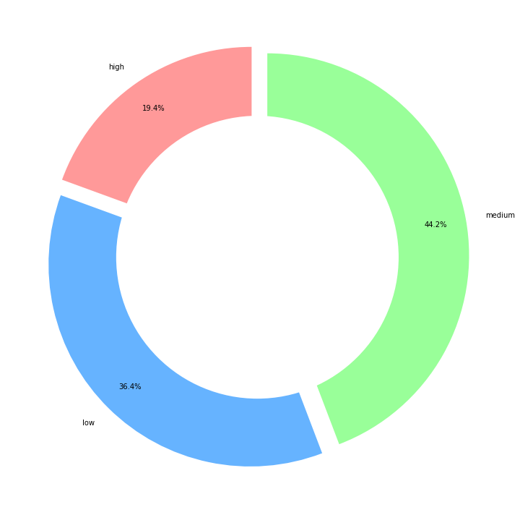
04
Conclusion and Discussion
Many wrong predictions of high and low categories to median
Gaussian mixture, K-means
Better performance on separating high and median rating wine
Appropriate for predicting high-quality wine
Imbalanced data

Slide 18
Thank you!
Q & A

